Slide 1
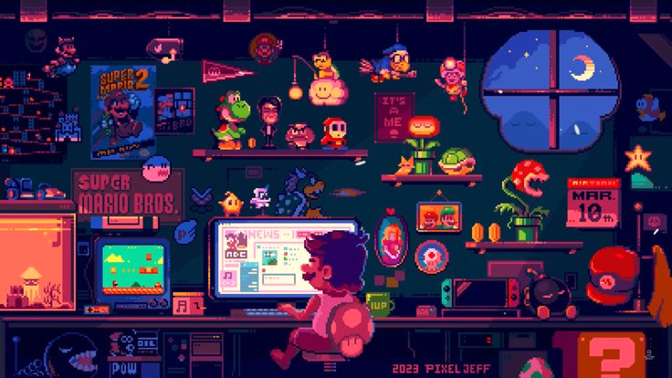
Snappy Snake FINAL
Present by Tuan Q. Tran
from GEx 2025

Slide 2
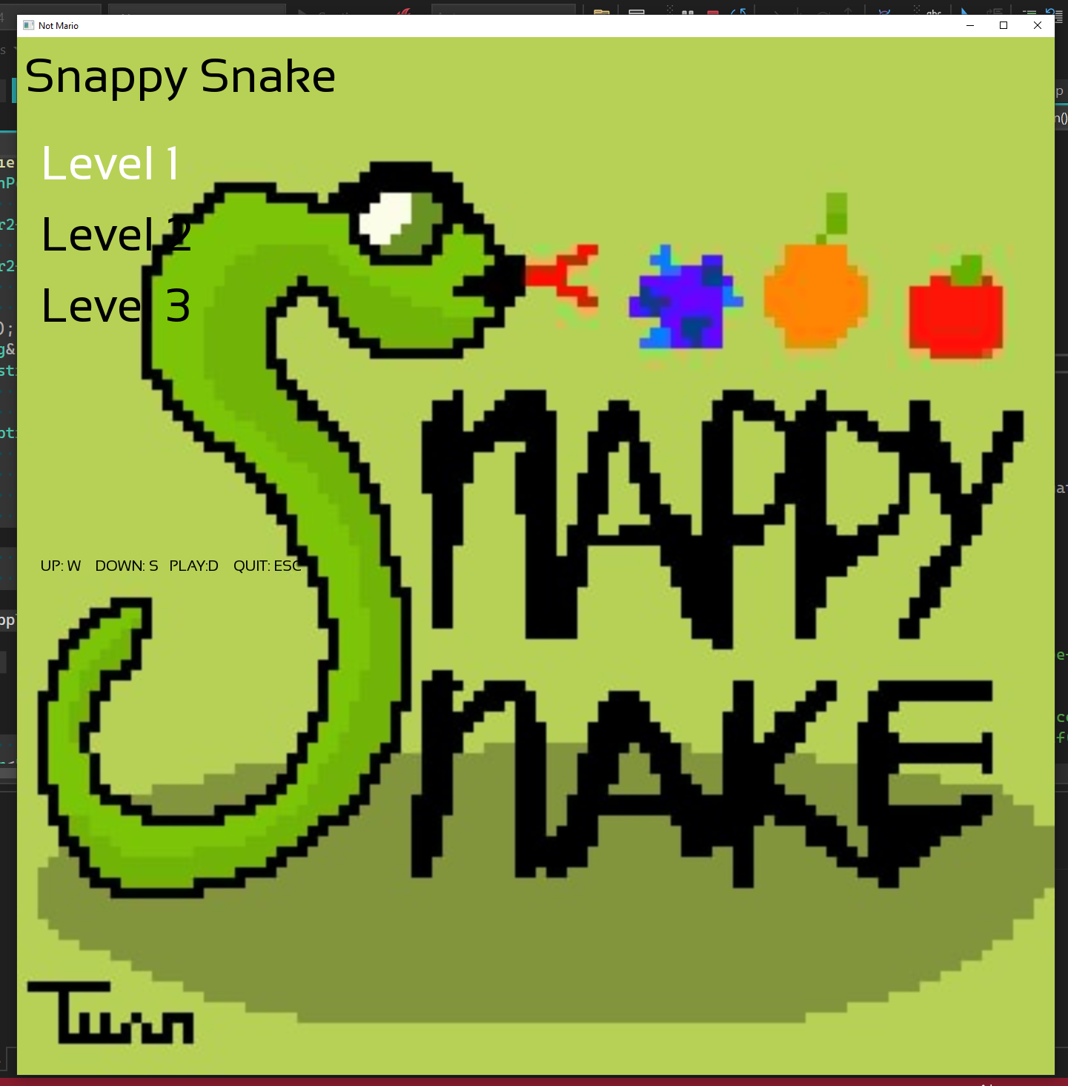
What is this game?
This is a customized version of the classic Snake game, built using C++ and SFML. The player controls a snake, navigating a grid-based world, eating different fruits with different effects to grow while avoiding collisions.
The objective is to survive as long as possible by eating apple, which increase the snake’s length and score. The challenge is to avoid crashing into the walls or the snake’s own body.”

Slide 3
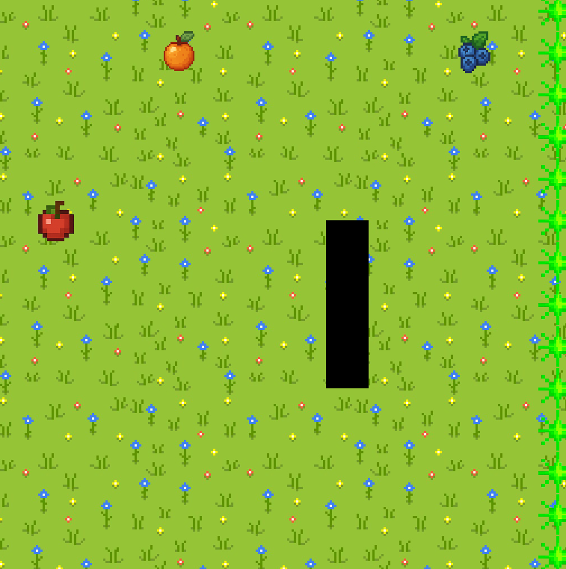
Core Mechanics
Snake Movement: The player moves in six directions (left, right, left-up diagonal, right-up diagonal, left-down diagonal, right-down diagonal).
Fruits Collection: Apple, Orange, and Blueberry.
Apple will grow the snake
Orange will shrink the snake
Blueberry will slow down the snake
Scoring System: Every fruits collected adds points to the score.
Game Over & Restart: When the snake dies, the player is presented with a game over screen to type in their name to save their score or not. Then they will be led to the menu screen.

Slide 4

Tools & Technologies Used
Programming Language: C++
Graphic Library: SFML
Development Environment: Visual Studio
Version Control: GitHub
Game Engine: Gex Game Engine
Illustration: Procreate for iPad

Slide 5

Thanks for listening
Present by Tuan Q. Tran
from GEx 2025

